Slide 1
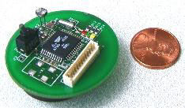
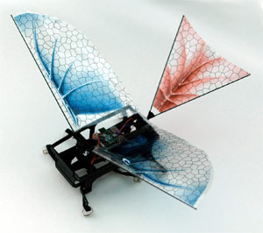
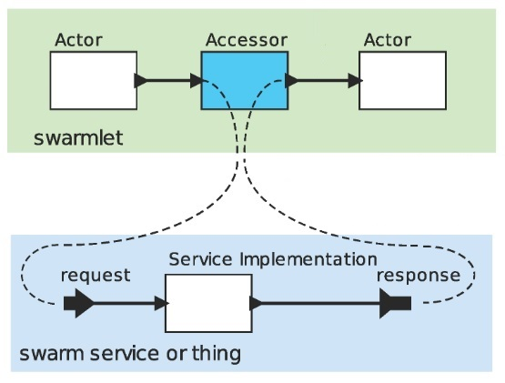




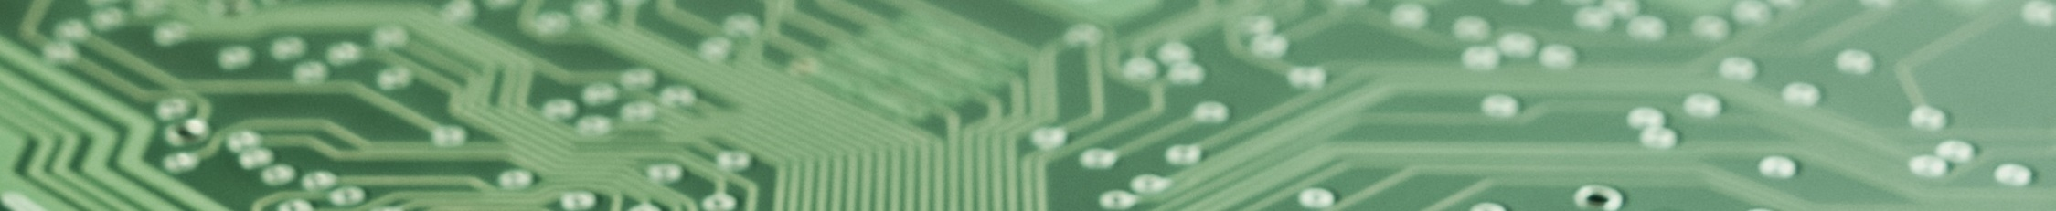
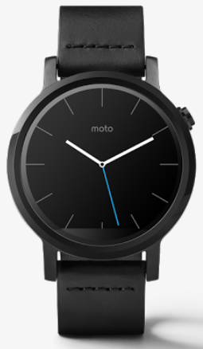
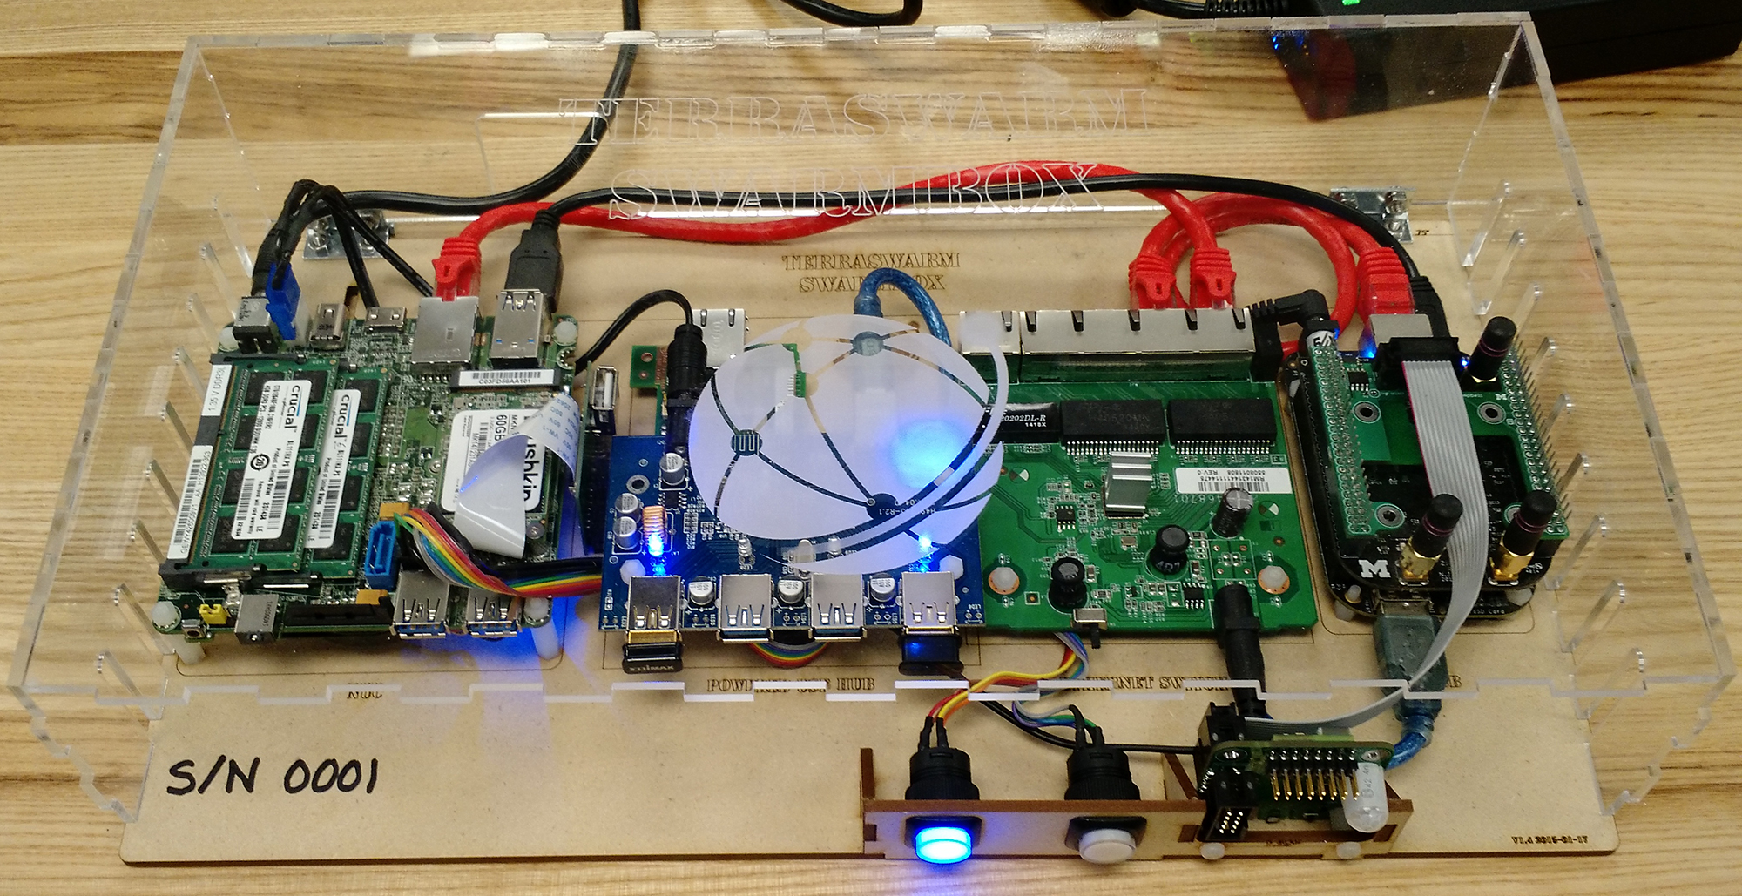
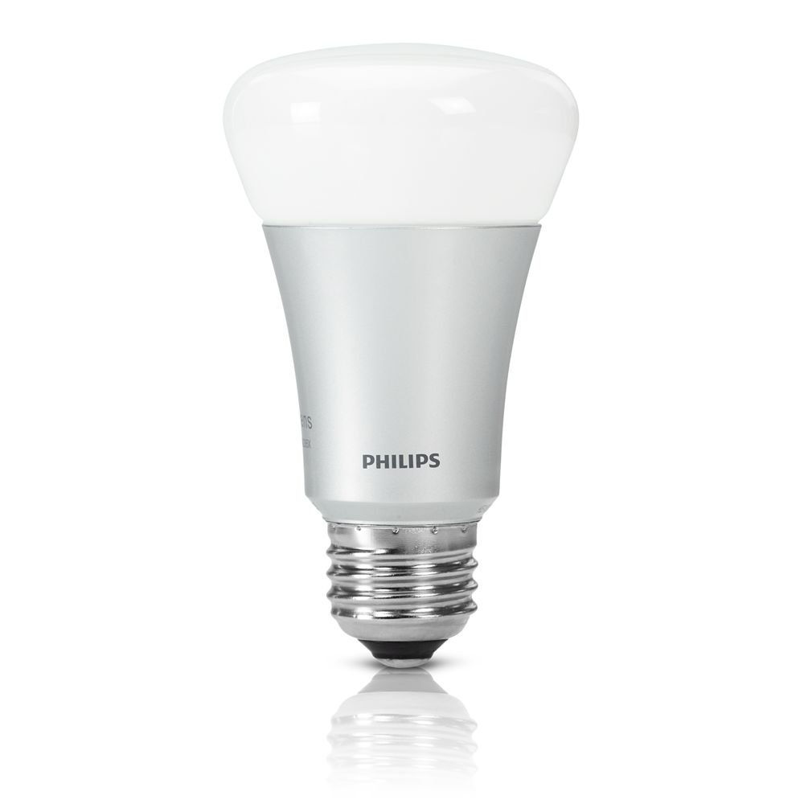
Accessors: Scalable IoT Programming
Elizabeth Osyk, Jian Wu, Christopher Brooks, Roozbeh Jafari, Edward Lee (UCB, TAMU)
Accessors: Go with the flow.
…more pictures
The Internet of Things
generally uses
an actor-oriented
programming paradigm.
React to streaming input,
produce streaming output.
An accessor wraps a
(possibly remote)
device or service
in an actor interface.
Accessors can be
composed to form
swarmlets.
The architecture encourages composition of
heterogeneous, multi-vendor devices and services.
Creating interfaces to various data streams
is the current focus of most IoT platforms.
Programming the Internet of a Few Things
Write once, run anywhere.
Take it to a higher level (of abstraction).
JavaScript, to
Module, to
Host (picture)
The testing platform follows the same.
Add some more about testing.
Unit test, Behavior-driven testing.
Add some pictures of hosts.
Label Java, Node.js, browser.
Accessors use a common API
plus host-specific modules
Run tests anywhere, too.
Movement
Gesture detection
Gesture reaction
Light control
Picture?
Smartwatch: Gestures are an
abstraction of the original data stream
Inheritance and composites
also supported
Programming the Internet of Everything
Maintain control.
(Reformat text nicely).
Many IoT systems will be control systems; therefore, we need REAL real-time support - proper timing abstractions and host implementations. Includes timed model of computation, preserving order of events. Note that Javascript timers aren’t real-time timers.
Mention vertical and horizontal contracts?
Other challenges to mention? Can think of plenty. Deployment, synthesizing new apps instead of finding an existing exact match, …
Challenges

